Slide 1
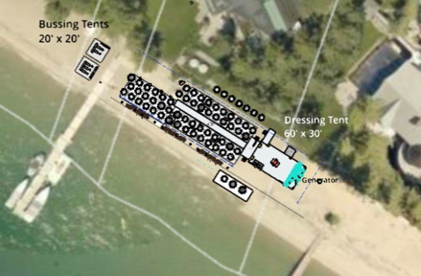
WADMIN18-0008 League to Save Lake Tahoe Annual Fashion Show and Luncheon, Outdoor Community Event
Washoe County Board of Adjustment
June 7, 2018

Slide 2
Overview
One-day outdoor community event
650 participants and 225 staff
LDS – 1 unit per acre
Luncheon and fashion show
1047 Lakeshore Boulevard

Slide 3
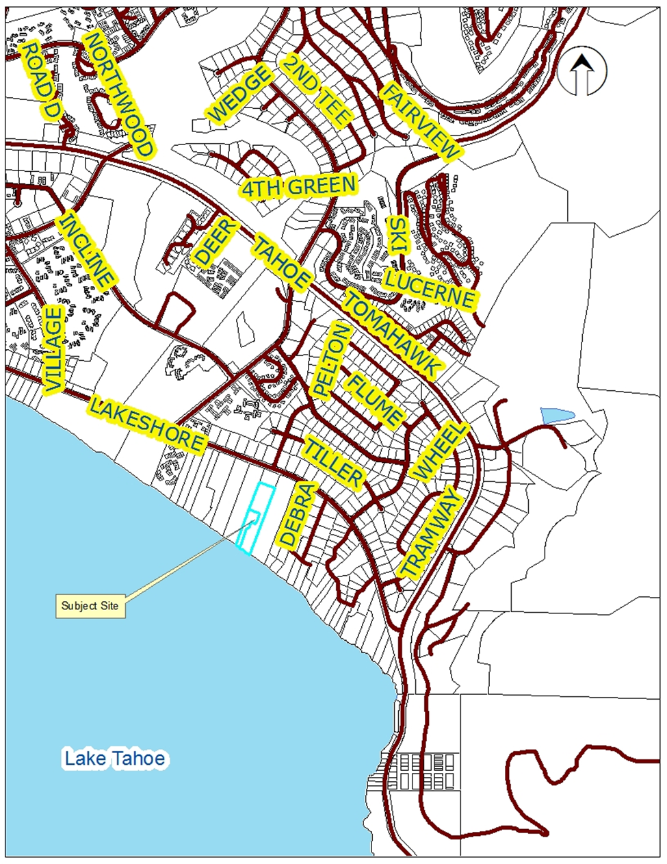
Location

Slide 4
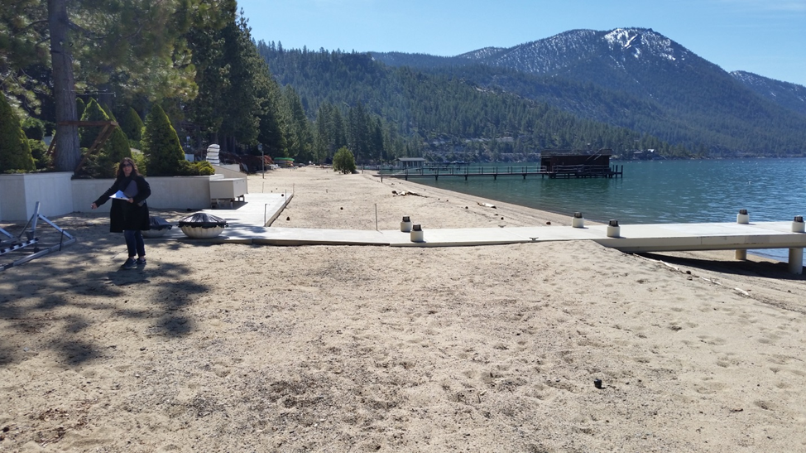
Location

Slide 5
Evaluation
Contracts provided for:
Security services
Fire and Emergency Medical Services
Sanitary facilities
Trash removal
Liability insurance provided
All parking at Sierra Nevada College
Amplified sound
Set-up and tear-down from 8 a.m. to 7 p.m. only

Slide 6
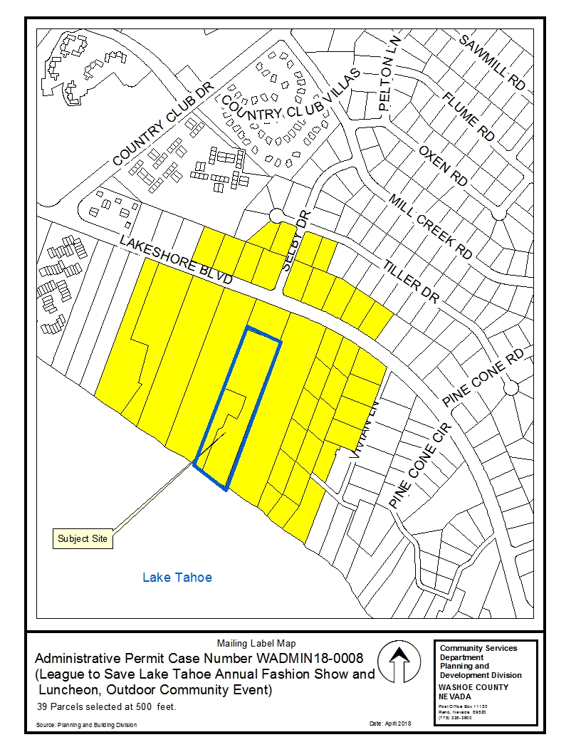
Public Notice & CAB
Notice sent to 39 property owners within 500 feet
Incline Village/Crystal Bay CAB, May 7, 2018 – recommended approval

Slide 7
Reviewing Agencies
Shown on pages 8 and 9 of the staff report
Recommended conditions of approval have been included
No recommendations for denial were received

Slide 8
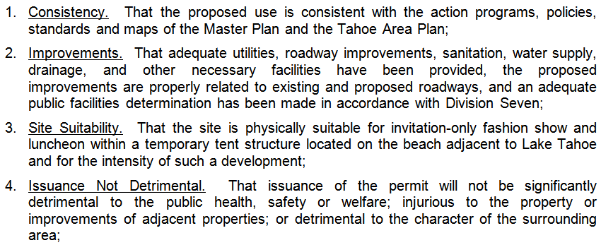
Regulatory Zone Amendment Findings

Slide 9
Possible Motion
I move that, after giving reasoned consideration to the information contained in the staff report and information received during the public hearing, the Board of Adjustment approve Administrative Permit Case Number WADMIN18-0008 for League to Save Lake Tahoe, and an Outdoor Community Event business license application and associated license conditions, for the League to Save Lake Tahoe Annual Fashion Show and Luncheon, having made the four findings in accordance with Washoe County Development Code Section 110.808.25, I further move to authorize the Director of the Planning and Building Division to issue the business license when all pre-event conditions have been satisfied.

